Slide 1

CodeX Link-Up Project
Share messages with each other -
no cell phone required!

Slide 2
CodeX Link-Up
No cell phones allowed! Communicate with each other using your CodeX.
Grab your CodeX device…
Let’s write some code!

Slide 3
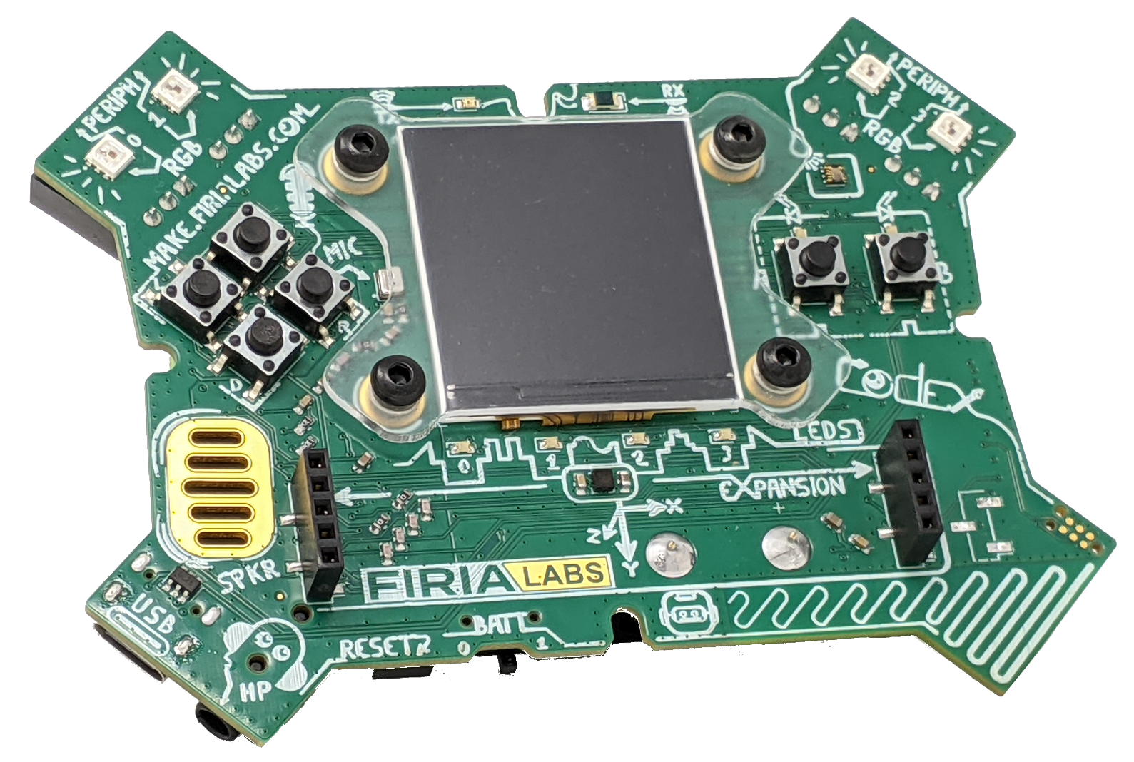
CodeX Buttons
Two CodeX buttons will be used for input.
Find buttons A and B on the CodeX.
BTN_A
BTN_B

Slide 4
Radio Communication
Each CodeX has 13 radio channels to choose from:
Channels are numbered 1 through 13
All CodeX on the same channel can easily communicate with each other. You can:
  Send a message
  Receive a message

Slide 5
Radio Communication
Messages sent using radio are strings.
A string is a sequence of characters, like words or sentences.
A string is the data type str.
A string is enclosed in quotation marks.
You can use double quotes “message” or
single quotes ‘message’.

Slide 6

Coding First Steps
You will use CodeSpace for this project.
Go to make.firialabs.com
Log in (use your account)
Go to the Sandbox
  Right side bar, near the bottom

Slide 7

Start the program
In the text editor:
Start a new file: linkup
Import the radio library (module) first!
Then import the codex library (module):
NOTE: spelling and capitalization matters!

Slide 8
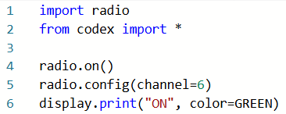
Step 1
Turn on the radio and set the channel.
Everyone in the class will be on the same channel.
Display a message on the screen to indicate CodeX is ready.

Slide 9
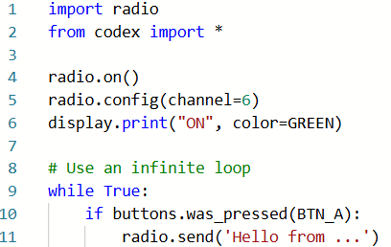
Step 2
Use an infinite loop.
If BTN-A is pressed, send a message!
Use your name instead of …

Slide 10
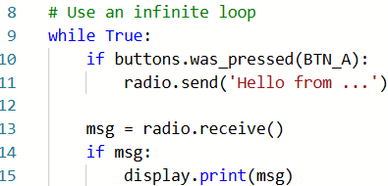
Step 3
Listen for a message.
If a message is received, display it on the screen.
Pay attention to the indenting!

Slide 11
Try it
Run the code
Press the
Press BTN-A on the CodeX
Do you see messages from other classmates?

Slide 12
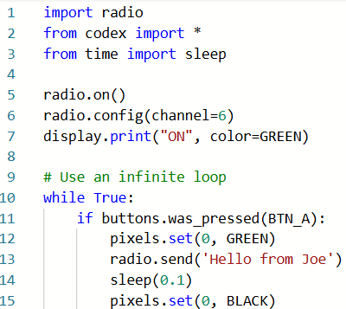
Step 4
How do you know if your message was sent?
Add a pixel indicator. Blink a pixel when your message is sent.
Don’t forget to import sleep!

Slide 13
Try it
Run the code.
Press the
Press BTN-A on the CodeX
Do you see the pixel blink when you send a message?

Slide 14
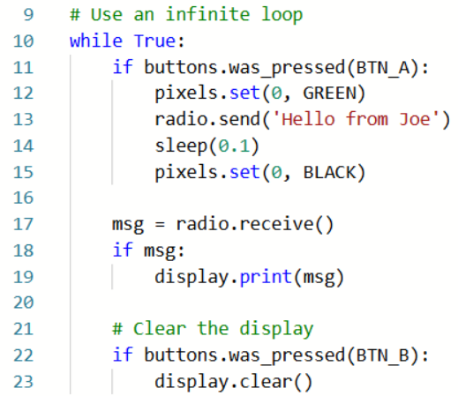
Step 5
Clear the display.
Your screen is getting pretty full!
Use BTN-B to clear the screen.

Slide 15
Try it
Run the code.
Press the
Press BTN-A on the CodeX.
Receive messages from your classmates.
When your display screen is full, press BTN-B to clear it.

Slide 16
Extensions
Add to your code so the program does even more!
Select a channel for just your group of friends.
Choose which message you want to send.
Add color to your message.

Slide 17
Extension #1
Choose a channel for your group.
The CodeX radio has channels numbered from 1 to 13.
Talk with your friends and select an odd numbered channel: 1, 3, 5, 7, 9, 11, 13
Two consecutive channels, like 1 and 2, could receive each other’s messages.
Change the channel setting in your code.
Then send and receive messages only to other CodeX on that channel.
Notes:
Link to color picker software: https://htmlcolorcodes.com/color-picker/

Slide 18

Extension #1
Choose a channel for your group.
Notes:
Link to color picker software: https://htmlcolorcodes.com/color-picker/

Slide 19
Extension #2
Code more buttons.
Use other buttons to send different messages.
You can use buttons U, D, L and R as well as A.
For each button, code an if statement.
Be careful with your indenting!

Slide 20
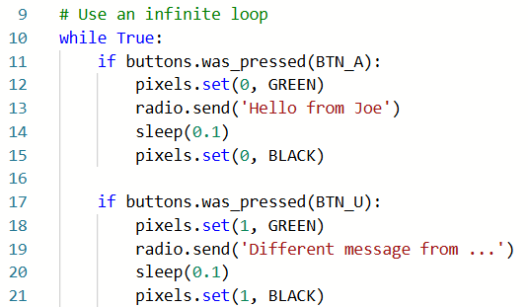
Extension #2
Example:

Slide 21
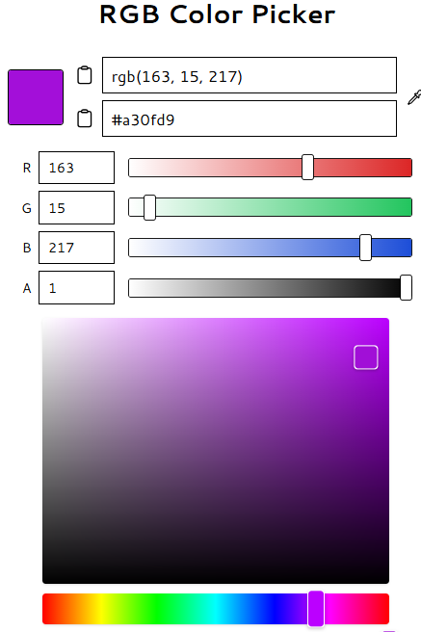
Extension #3
Choose a color for your message.
Use online software to select a color and find the RGB triplet.
In this example, the purple color is (163, 15, 217)
Notes:
Link to color picker software: https://htmlcolorcodes.com/color-picker/

Slide 22
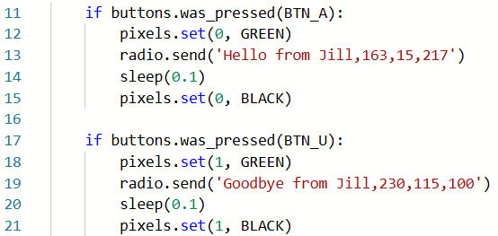
Extension #3
Add the RGB colors to your message.
Include the numbers in the quotation marks.
Use commas and NO SPACES!!!
Add a color for each message.
Notes:
Link to color picker software: https://htmlcolorcodes.com/color-picker/

Slide 23
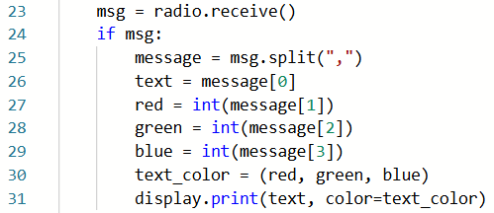
Extension #3
When you receive a message, you need to split it into the text and the RGB colors:
Notes:
Link to color picker software: https://htmlcolorcodes.com/color-picker/

